Slide 1
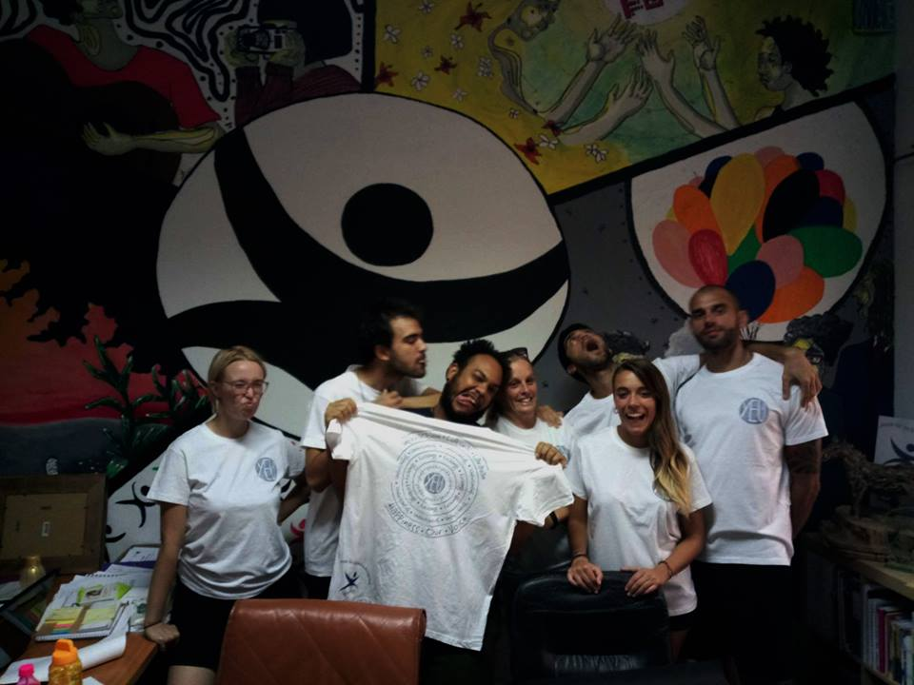
ESC Project
Mission Tradition
YEU Cyprus

Slide 2
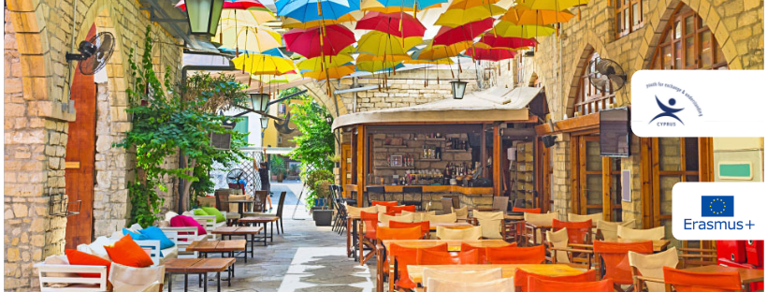
Introduction
Dear future ESC Volunteers, We are happy to welcome you to this project! Please read the following information carefully in order to prepare for the coming time in Cyprus. Seven volunteers from six different countries will come to Cyprus and share their experiences, skills and knowledge. You will have the opportunity to exchange your thoughts, experiences, visions, wishes and knowledge and have an unforgettable experience in Cyprus. But let’s take the things from the beginning…

Slide 3

YEU Cyprus
YEU Cyprus stands for Youth for Exchange and Understanding Cyprus and it is a nonpolitical, non-governmental organization (NGO) based in Nicosia, Cyprus.
Since 1995, the aim of YEU is to foster closer co-operation and better understanding among youngsters through the exchange of experiences and ideas. It is one of the biggest youth organizations in Cyprus numbering more than 1000 members and is considered one of the most active organizations of the island, realizing several activities both on an international and local level.

Slide 4
YEU Cyprus activities:
On an international level, we organize and deliver training courses, focusing always on the youth’s development, awareness raising and capacity building. The methodology of the activities is based on non-formal education and experiential learning.
Providing the opportunity to participate in international activities abroad such as in partner’s training courses, youth exchanges, European Solidarity Corps (ESC), seminars, SALTO events etc.
On a local level, YEU Cyprus has organized and still organizes various activities such as Human Libraries, workshops and seminars on different topics (for example human trafficking, non-formal education, volunteering), street festivals, laughter festival, field trips and other activities.
→ For more information have a look at our Facebook page or our webpage.

Slide 5


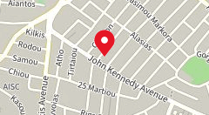
YEU Cyprus Contact Information
Phone number
YEU: 00357 99573646
E-mail address:
evs@yeu-cyprus.org
info@yeucyprus.org
Address of YEU:
27 Ezekia Papaioannou,
1075 Nicosia

Slide 6
What is the Mission Tradition Project about?
Mission
The project aims to encourage young people to believe in themselves and improve their artistic and interpersonal skills by exploring, interacting, experiencing and recording the traditions and the culture of Cyprus. By organizing different events for the society, engaging in solidarity activities and promoting volunteerism, we expect to make young people more active as citizens. The project will ensure the promotion of social inclusion and equal opportunities.
Our long-term goal is to involve volunteers in public activities and events with the purpose to rekindle the interest of young Cypriots in the rich and multidimensional cultural heritage of the island.

Slide 7
Activities
Together with the volunteers, we will realize a variety of different events, revolving around Tradition and Cultural Heritage, such as a Cultural Festival, Music events, a Human Library event, Sports events and many more. In this way, the volunteers will have the opportunity of assisting the coordinating team and gain through this experience useful organizational and social skills.
In parallel with these events, they can additionally lead intercultural workshops and personal projects (movie nights, traditional games nights, language courses, theatre, music, dance, etc.) to promote their own countries and volunteerism; with access to a conference room, music equipment and art materials.

Slide 8
Volunteer’s profile
Competencies and motivation to work with people coming from different backgrounds. They should be willing to learn new things.
Even if is not a strict prerequisite, would be preferable for the volunteers to have an artistic or cultural background.
Preferably be over 20 years old, open-minded towards multiple working methods, different languages and cultures and be interested to create new experiences in an inter-cultural environment.
They should also show that they are able to support themselves financially-wise, throughout the period that the project is being carried out.
We do not require any previous qualifications, educational level, specific experience or more than basic language knowledge.

Slide 9







Volunteers will be chosen regardless of their ethnic group, religion, sexual orientation or political opinion and we will ensure that there is a gender balance. We will need seven volunteers coming from:
Italy
Spain
France
Romania
FYROM
Czech Republic!

Slide 10

Period of the Project
3rd of March 2020 – 30th of April 2020
Working hours
ESC must be full-time service for the volunteer. Her/his project activities (including language and other training activities relating to the project) should take up at least 30 and not more than 38 hours per week (around 7 hours per day). The volunteer is entitled to two consecutive free days per week and two days of holiday per month.

Slide 11

Health insurance
Sending organization is responsible to register the volunteers to the CIGNA INSURANCE at least 14 days before departure. Volunteers will also receive from the sending organization information about the coverage and the procedure of CIGNA INSURANCE. Volunteers are strongly advised to have the European Insurance card with them given by their national provider.

Slide 12

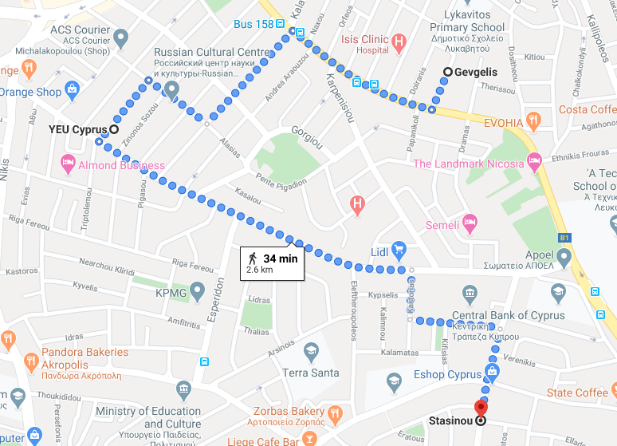
Accommodation
The accommodation will be at a house close
to the city center of Nicosia. Three of the
volunteers will share a house in Gevgelis
Street and the other four will share an
apartment in Stasinou Street which are
very close to YEU office. Each volunteer will have their own bedroom and will share the common areas such as the kitchen facilities and living room.

Slide 13

Finances
Every volunteer will receive 130 Euros for food allowance and 155 Euros for pocket money each month. The accommodation will be provided by YEU Cyprus. The volunteers are requested to be very careful on electricity and water bills. A maximum allowance of 75 Euros will be provided for Electricity and Water bills per month for each house. In case that amount is exceeded, the volunteers will be requested to provide the extra costs.

Slide 14

Benefits of being part of an ESC
Empowering self-management and work-related skills.
Strengthen existing skills through practice and experience.
Reflection of interpersonal skills through work and communication with others.
Experience in decision making and problem solving.
Leadership development opportunities.
Increased ability to learn from experience.
Strengthen communication skills, spoken and written.
Cultivating team spirit and teamwork and synergy skills.
Encourage initiatives and free creativity.
Improving independence.
Enriching cultural knowledge.
Youth Pass.

Slide 15

What to Bring
Comfortable clothing (Cyprus is well known for its really hot weather but it can also get quite cold in winter)
Medication, if needed
Laptop (in case it is difficult to bring one, please inform us)
Alarm clock (to avoid oversleeping)!
Motivation and good mood!

Slide 16
Cyprus
Floating on the waters of the European Mediterranean, but pointing longingly towards the shores of Syria, Turkey and Lebanon, Cyprus is an odd mixture. It is a kaleidoscopic blend: its cultural influences are dominated by Western Europe, but its geographic proximity to Asia and Africa gives it more than just a hint of the East. Long coveted by mainland Greece and Turkey, this small island has its own definite and beguiling character. Cyprus is the island for all seasons, the island of good weather, good mood and loads of sunshine! The people of Cyprus are warm – hearted, hospitable and kind, people who love to go out and who appreciate good company. The capital city, Nicosia, is a city which blends both history and the modern life while at the same time it is also the last divided capital in Europe. The northern part of the city functions as the capital of the Turkish Republic of Northern Cyprus, a disputed region recognized only by Turkey, and which the international community recognizes as Cypriot territory under Turkish occupation, and has done so since the Turkish invasion in 1974.

Slide 17
Of the Island
Historical Facts
During the Ancient history different civilizations lived on the island, such as: Mycenean and Achean Greeks, Hittites, Phoenician, Assyrian, Egyptians, Persians, Macedonian, Ptolemaics and Romans.
Middle Age: Byzantines, Arabs, Richard the Lionheart, Knights Templar and Lusignans.
Renaissance and Modern Era: Genoese, Venetians and Ottomans.
Contemporary History: British.
→ 1960, Independence and creation of the Republic of Cyprus.

Slide 18

Travelling to Cyprus and Transportation
In Cyprus there are two airports: Larnaca and Paphos airport
(International Airports). The Ercan airport located at the northern part of the island is not recognized by any other country except of Turkey so you are not allowed to use it to come to Cyprus for the project in order for you to get the money for the tickets.
For transportation, you can travel around within the city or between cities by bus. Check the following websites for more information:
1. http://www.cyprusbybus.com/
2. http://www.intercity-buses.com/
YEU Cyprus team will provide
the volunteers with bicycles
which they can use in their daily life.

Slide 19
Money and Currency
The currency of the Republic of Cyprus is the Euro.
Making Phone Calls
In order to make a phone call to Cyprus from abroad, dial 00357 and then the eight-digit phone number. If you wish to make a phone call abroad while in Cyprus, dial 00, followed by the country code and the telephone number. The organization will not provide SIM cards. Each volunteer is responsible to buy their own Cypriot SIM card.
Languages
Greek and Turkish are the official languages of the Republic of Cyprus spoken by the Greek-Cypriot and Turkish-Cypriot communities respectively. English is widely spoken. French, German and other languages are also well spoken within the tourist industry.

Slide 20

Religions
Cyprus enjoys an exceedingly high level of freedom of worship. While
the majority of Greek-Cypriots are Greek-Orthodox Christians, other denominations are represented on the island, including Armenians, Maronites and Roman Catholics. The Turkish-Cypriot community is
predominantly Muslim.
Weather Conditions
Cyprus enjoys an intense Mediterranean climate of really hot dry summers starting in mid-May and lasting until mid-September and rainy, quite mild winters from November to mid-March. March-May are the months when weather in Cyprus changes from spring to summer. The summer months are very hot so you will need comfortable and light clothing. Don’t forget to bring your swimming suit. Recommended clothes are comfortable medium-weight and summer apparel with
light jumpers or long sleeved clothes for the evenings.

Slide 21
Cypriot Cuisine
People in Cyprus appreciate good food. In fact, most of the social outings and relationships revolve around food! And that’s food that is coming in a lot of variety and large quantities for massive stomachs!
While in Cyprus it’s a must that you try:
• Cypriot meze (appetizers akin to Spanish tapas) are an art form. Meze are available in a meat variety or fish variety but quite often come as a mixed batch, which is rather pleasing.
• Sheftalia which is a kind of sausage without skin. The filling of Sheftalia is made of ground pork or lamb shoulder and leg. It is mixed with fine chopped onions and parsley and seasoned with salt and pepper. Instead of sausage casing it uses caulk fat, the membrane that covers the stomach of a lamb or pig, to wrap the ingredients. In words it may not sound so good but in the mouth it is simply yummy yummy!!!
• Halloumi is a uniquely Cypriot cheese, made from a mix of cow's and sheep's milk. Hard and salty when raw, it mellows and softens when cooked and is hence often served grilled.
And of course this is just a short list. There are plenty more tastes and dishes to try!

Slide 22

Another important thing about Cyprus is the social life of Cypriots who normally spend their free time (mornings, afternoons, evenings, we
simply don’t mind) going for coffee in several coffee shops around the city, that stay open until around one o’clock at night! Coffee is quite
popular even at 10 or 11 pm and what is also very popular is the special frappé (foam-covered iced coffee drink made from instant coffee), which seems to be something like a Greek coffee invention. Later during the evenings people hit the clubs at around 12:30 with the party lasting until the early hours of the morning, when again they try to get rid of the hangover with more food at local fast food restaurants.
For more information visit:
1. http://www.visitcyprus.com/
2. http://www.heartcyprus.com/
and follow these facebook pages:
3. https://www.facebook.com/VisitCyprus.cy/?fref=ts
4. https://www.facebook.com/HeartCyprus/

Slide 23

How to apply for ESC
Send a motivation letter and CV via email to YEU Cyprus. As hinted by the title of it, in the motivation letter you should explain your motivation for volunteering at that particular project and organization. Include your hobbies and particular skills in your CV – these are potentially more important during the selection criteria than experience gained through paid work.
Fill in the application form and send it via email to YEU Cyprus, by the 28th of February 2019.

Slide 24

We look forward to meeting you!!!
If you have any questions please don’t hesitate to contact us.
Email: evs@yeu-cyprus.org
info@yeucyprus.org
Phone number: 00357 99573646
Thank you!
The YEU Cyprus Team

